Slide 1

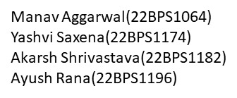
BECE204P – MICROPROCESSORS AND MICROCONTROLLERS
PROJECT PROGRESS REVIEW
Submitted by :-

Slide 2
PROJECT TITLE AND OVERVIEW:-
PORTABLE RFID ATTENDENCE SYSTEM
The final outcome of this project is going to be a portable device for attendance management.
The main components include a microcontroller and a RFID tag reader.
The microcontroller is programmed such that it would extract required information when an ID card touches the RFID tag reader.
After that all the information will be arranged and transferred to a laptop using USB cable.
Along with these it also has a slot wise system making it easy to access for professors.

Slide 3
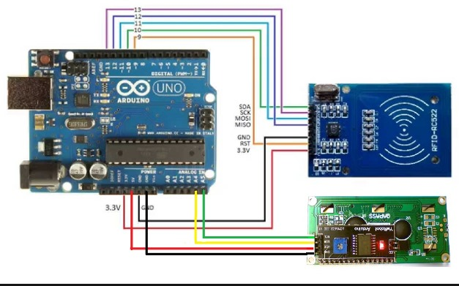
WIRING DIAGRAM:-

Slide 4
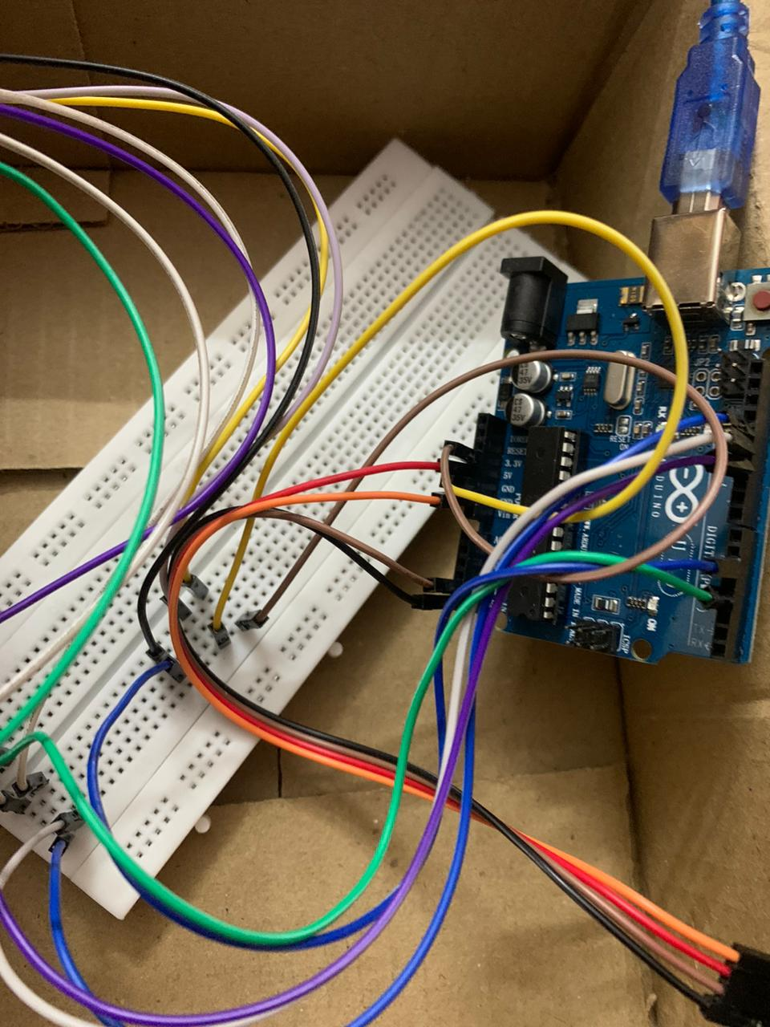
PROGRESS AS OF NOW:-
CONNECTIONS MADE USING PROGRESS DIAGRAM:-

Slide 5
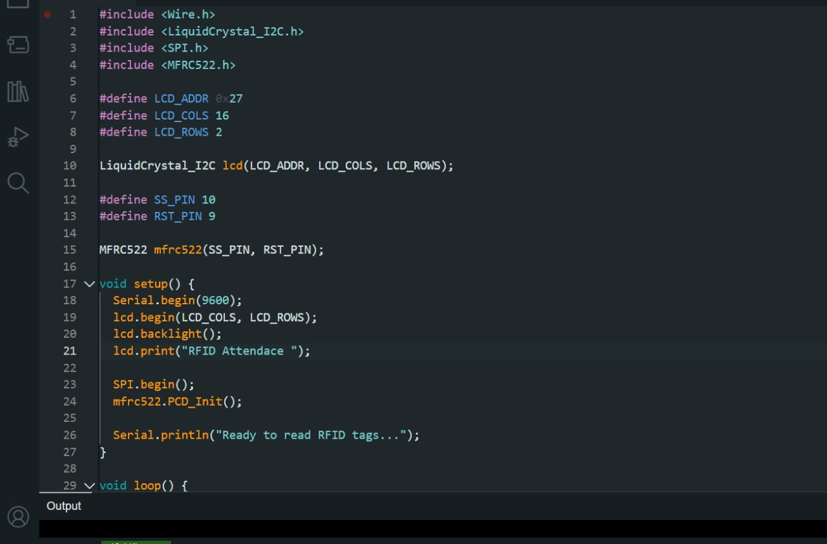
PROGAMMING THE RFID TAG READER:-

Slide 6
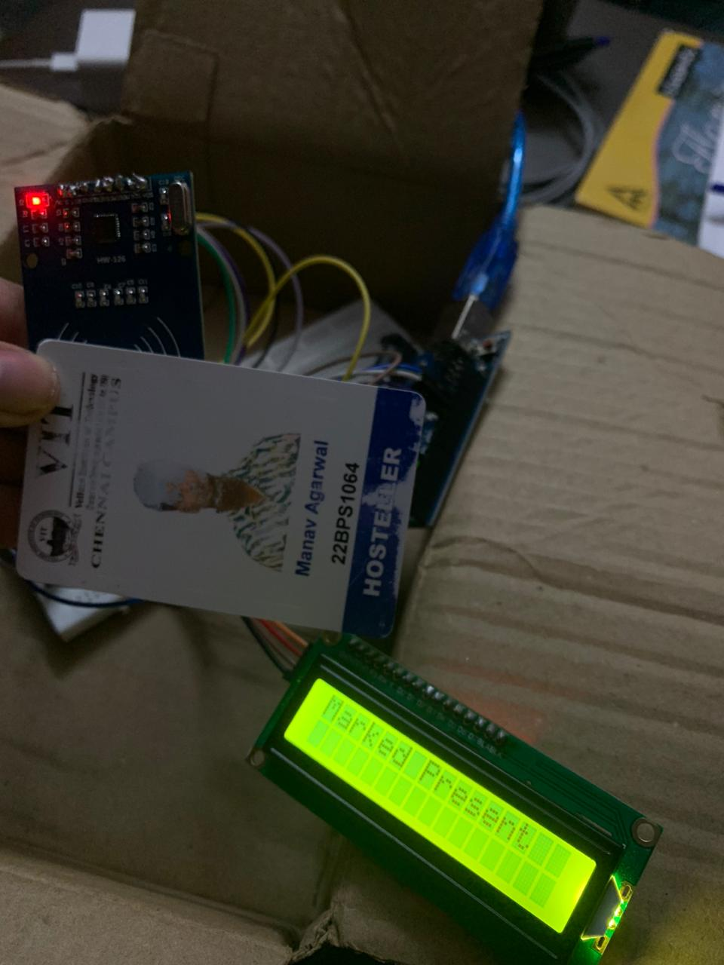
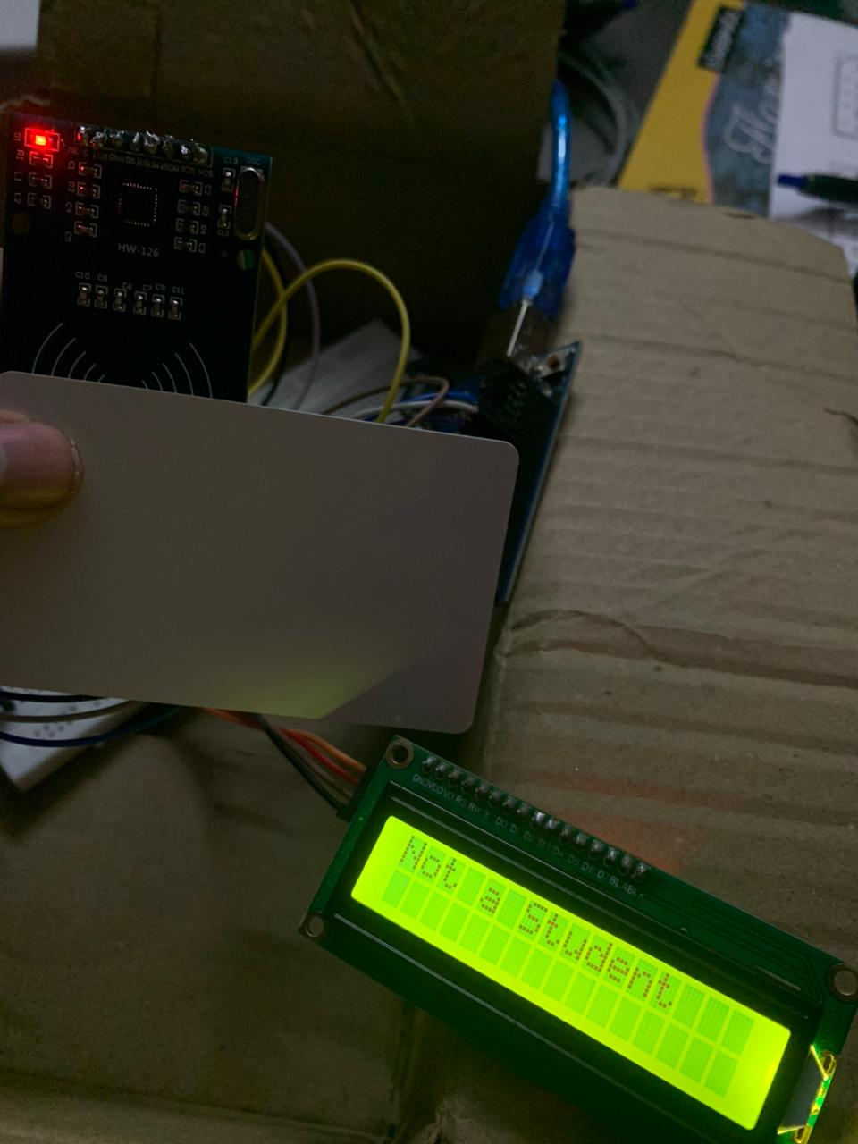
RFID READING PRESENT FOR CLASS STUDENT
AND “SHOWING NOT A STUDENT” FOR OTHERS

Slide 7
WORK TO BE DONE:-
INTEGRATION OF JOYSTICK.
MAKING EXCEL DATABASE.
MAKING A PORTABLE CONTAINER WITH BATTERY.

Slide 8
Thank you.

